Slide 1
[A065RP17(8)P]
[Drop Test]
Corrective Action Report
Date: 2020/06/03

Slide 2
˙Content
Issue Description
Root Cause Analysis
Risk Assessment
Corrective Action
Preventive Action

Slide 3
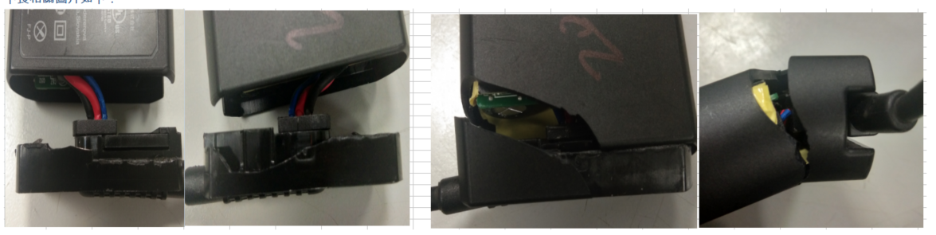
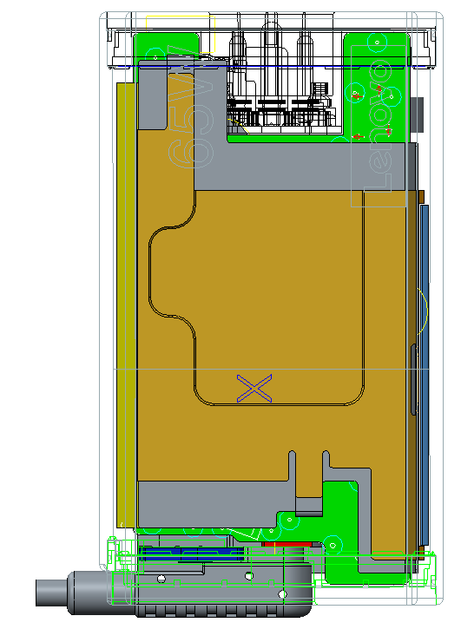
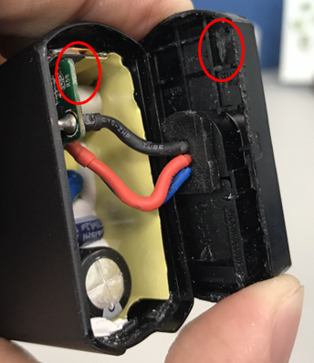
˙Issue Description
A065RP17(8)P-LN01 can’t meet the Lenovo spec of dropping test :
Height=1.2m，6 Surfaces、8 Corners，2 Cycle，total 28 times
←MP ORT test fail 2pcs (total 5pcs)
˙Root-Cause Analysis
◎ Scrubbing mark on DC-Case & PCB
Scrubbbing mark
scrubbing mark
→Internals shifted to hit the case during the drop test.

Slide 4
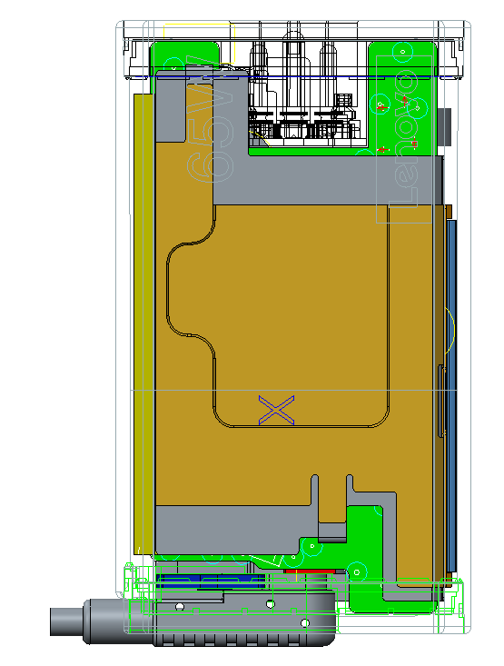
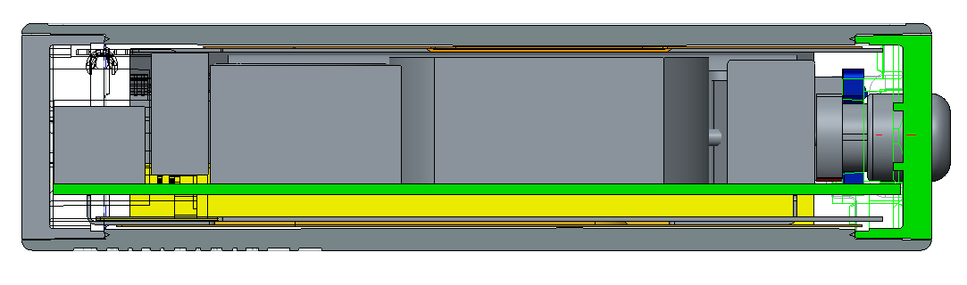
●TA (Before): Gap between Case & PCB
X
F(Step)
B(Step)
E
D
C
X
A
→Gap must be bigger than 1.25mm at least for assembly required.(0.625 mm each side)

Slide 5
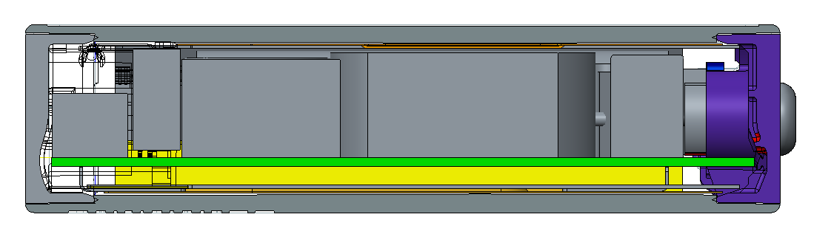
˙Risk Assessment
Can meet the IEC 60950，no safety concern。(list comparison as below)
-IEC 60950 : 750 mm ± 10 mm for desk-top equipment as described above (any 1-face)
-Lenovo : 1.2M drop onto concrete floor. 2 cycle(6-faces + 8-corners)
-Hp : 36-inch (92cm) drop onto hardwood surface. (any 3-faces)
-Dell : The adapter will dropped from a height of 36”(92cm) onto an concrete floor. (6-faces )
˙Corrective Action
1. Tooling modified to enlarge the Gap between PCB & CASE from 0.3mm to 1.5mm each side (Gap>0.65mm by TA) to correct assembling risk(like interference) .

Slide 6
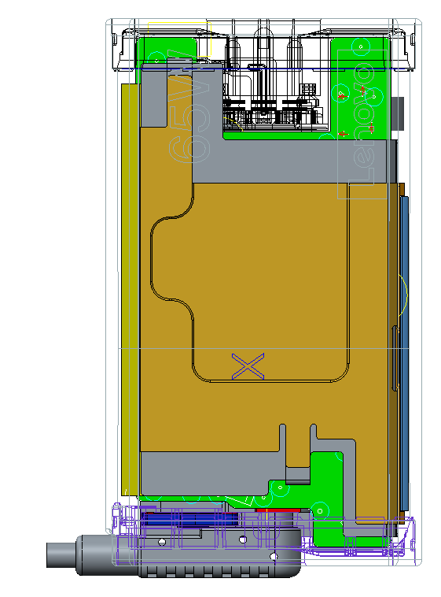
● TA(After) : Gap between Case & PCB
F(Step)
B(Step)
E
D
C
X
A

Slide 7
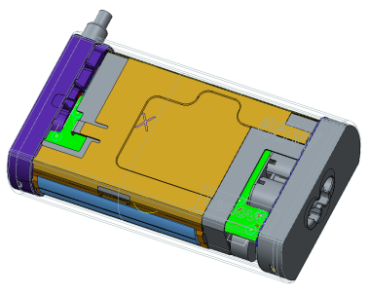
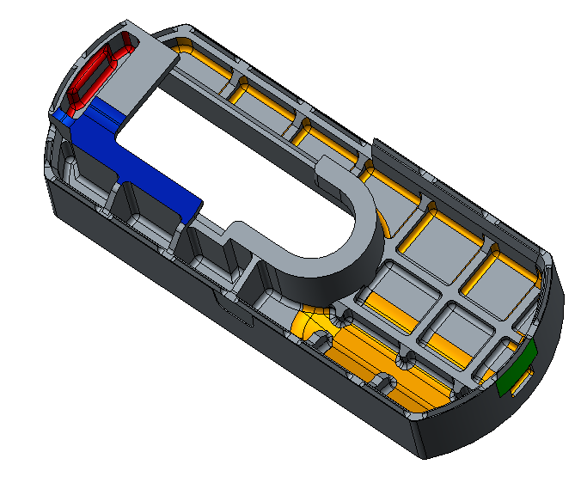
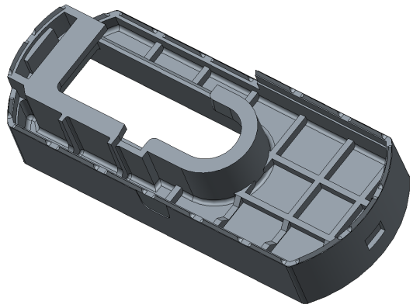
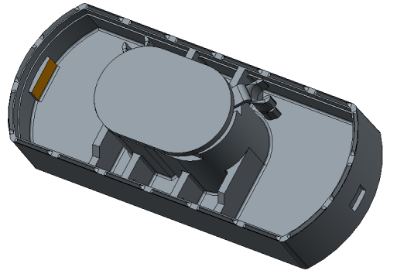
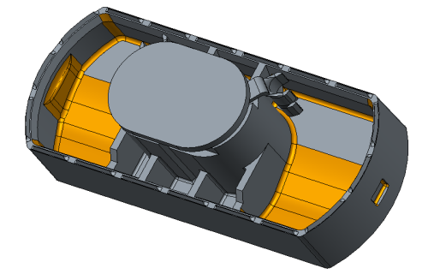
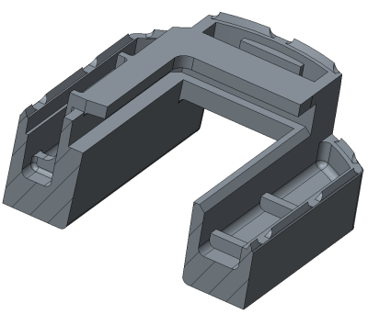
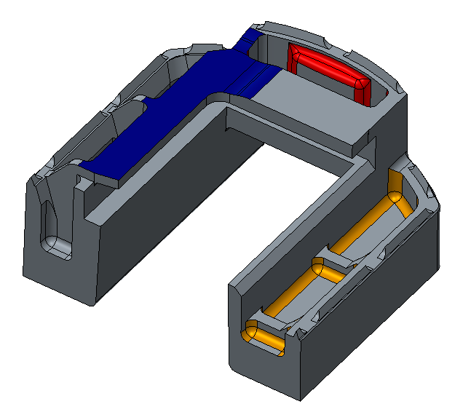
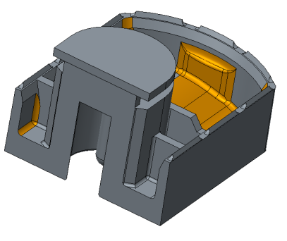
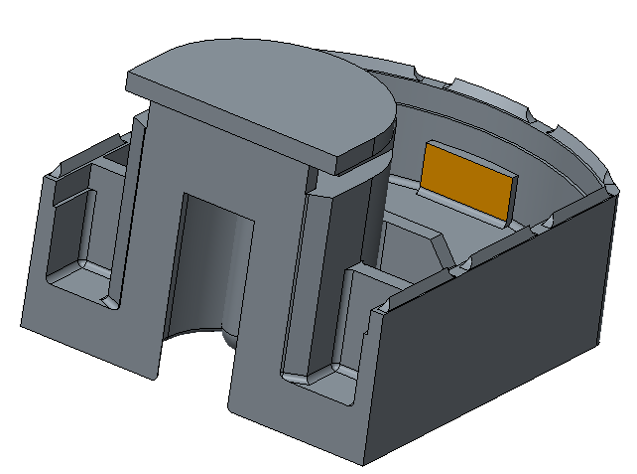
2. Reinforce the structure to enhance the Impact resistance when internals shifted in machine.
DC_CASE
AC_CASE
●DC-CASE:
●AC-CASE:
Before
After
Before
After
S
D1
D-2
S
S
S
D1
D-2
t=1.0
t=1.2
t=1.0
t=1.2
S1-S1 Section
S2-S2 Section
D1-D1 Section
D2-D2 Section

Slide 8
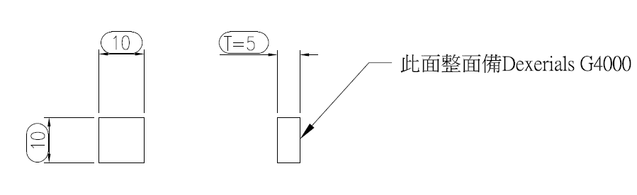
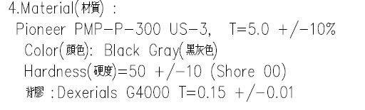
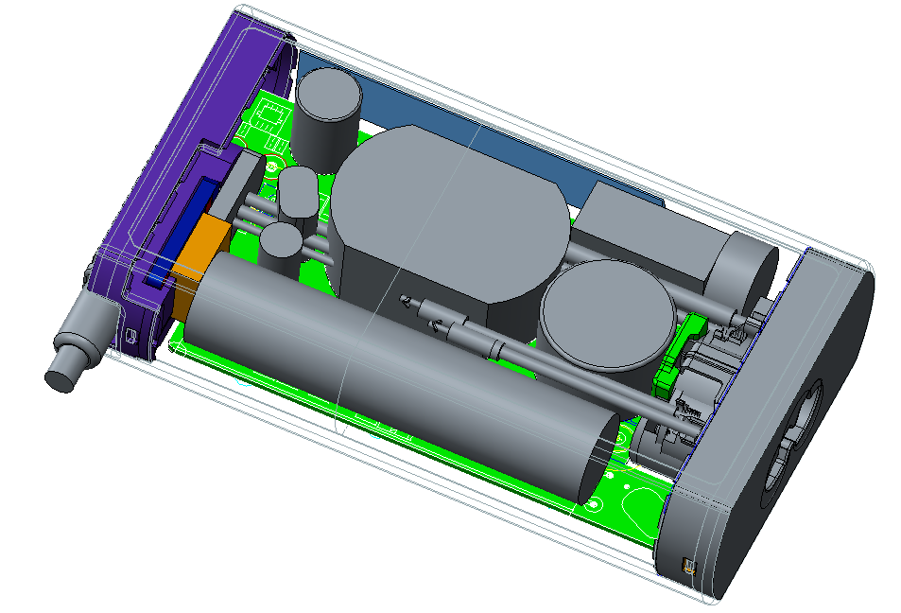
3. Add cushioning materials-Pad between PCB&CASE to absorb the impact

Slide 9
●TA comparison chart(Before & After)
Before
After
-By TA We can know there are enough assembly clearance after we modified the case thickness from 2.7 to 1.5mm.

Slide 10
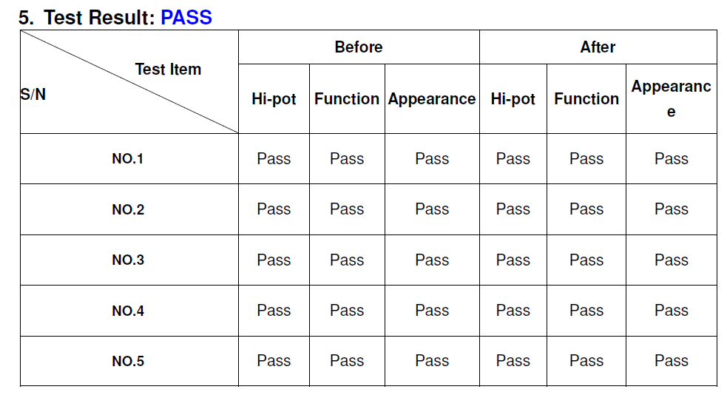
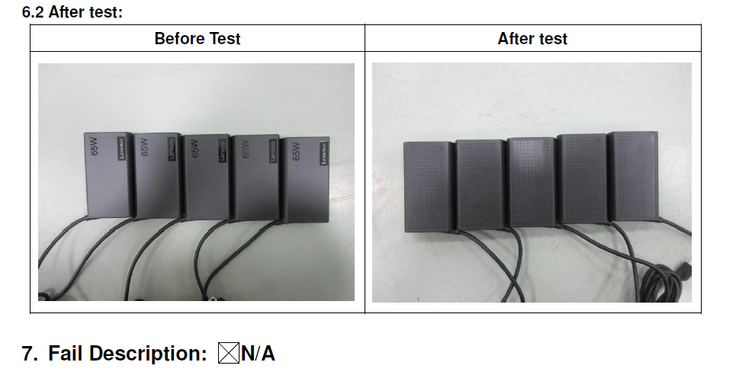
●Test result

Slide 11
˙ Preventive Action :
to Pass the spec of Lenovo dropping test : 1.2mm ；6 surfaces & 8corners for 2cycles 。
1.Reserve enough gap at least 0.8mm each side between Case & PCB
(to prevent assembling interference )
-This case condition:
●Step of cosmetic spec : +0.2/-0mm (to sink below the ultrasonic surface )
●Make sure case’s thickness is strong enough to suffer the impact (sufficient ribs& radius structure in corner).
F(Step)
B(Step)
E
D
C
Target
(Gap)
Target
(Gap)
A

Slide 12
2. To Fix the internals by snap 、hook or anything else .
If there are no sufficient conditions to add it , we suggest to enlarge the gap between
case & PCB to 1.5mm or more & add sponge or pad to be cushion.
3. Increase the difficulty in internal verification.
in this case, drop test spec : Height=1.2m；6surfaces 8corners，2Cycle。
Increase level to Height=1.5m；6surfaces 8corners，2Cycle。
to make sure when accident happen , we still can pass the test reliably.

